Slide 1
Artificial Intelligence in Agriculture

Slide 2
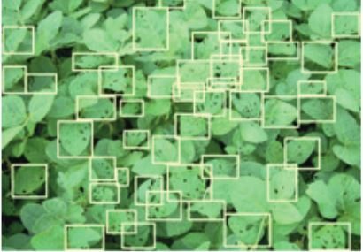
According to UN Food and Agriculture Organization, the
population will increase by 2 billion by 2050. However, only
4% additional land will come under cultivation by then.
In this context, use of latest technological solutions to make
farming more efficient, remains one of the greatest imperatives.
While Artificial Intelligence (AI) sees a lot of direct application
across sectors, it can also bring a paradigm shift in how we see
farming today. AI-powered solutions will not only enable
farmers to do more with less, it will also improve quality and
ensure faster go-to-market for crops.
In this article, we will discuss how AI can change the agriculture
landscape, the application of drone-based image processing
techniques, precision farming landscape, the future of
agriculture and the challenges ahead

Slide 3
1. Growth driven by IOT
Huge volumes of data get generated every day in both
structured and unstructured format. These relate to data on
historical weather pattern, soil reports, new research, rainfall,
pest infestation, images from Drones and cameras and so on.
Cognitive IOT solutions can sense all this data and provide
strong insights to improve yield.
Proximity Sensing and Remote Sensing are two technologies
which are primarily used for intelligent data fusion. One use
case of this high-resolution data is Soil Testing. While remote
sensing requires sensors to be built into airborne or satellite
systems, proximity sensing requires sensors in contact with
soil or at a very close range. This helps in soil characterization
based on the soil below the surface in a particular place.
Hardware solutions like Robot (pertaining to corns) are
already pairing data-collecting software with robotics to
prepare the best fertilizer for growing f corns in addition to
other activities to maximize output

Slide 4
2. Image-based insight generation
Precision farming is one of the most discussed areas in
farming today. Drone-based images can help in in-depth field
analysis, crop monitoring, scanning of fields and so on.
Computer vision technology, IOT and drone data can be
combined to ensure rapid actions by farmers. Feeds from
drone image data can generate alerts in real time to
accelerate precision farming
Remote sensing techniques along with hyper spectral imaging
and 3d laser scanning are essential to build crop metrics
across thousands of acres. It has the potential to bring in a
revolutionary change in terms of how farmlands are monitored
by farmers both from time and effort perspective. This
technology will also be used to monitor crops along their
entire lifecycle including report generation in case of
anomalies.
3 Health monitoring of crops

Slide 5
The emergence of new age technologies like Artificial
Intelligence (AI), Cloud Machine Learning, Satellite Imagery and
advanced analytics are creating an ecosystem for smart farming.
Fusion of all this technology is enabling farmers achieve higher
average yield and better price control.
Microsoft is currently working with farmers from Andhra Pradesh
to provide advisory services using Cortana Intelligence Suite
including Machine Learning and Power BI. The pilot project uses
an AI sowing app to recommend sowing date, land preparation,
soil test-based fertilization, farm yard manure application, seed
treatment, optimum sowing depth and more to farmers which
has resulted in 30% increase in average crop yield per hectare.
Technology can also be used to identify optimal sowing period,
historic climate data, real time Moisture Adequacy Data (MAI)
from daily rainfall and soil moisture to build predictability and
provide inputs to farmers on ideal sowing time.
To identify potential pest attacks, Microsoft in collaboration with
United Phosphorus Limited is building a Pest Risk Prediction API
that leverages AI and machine learning to indicate in advance,
the risk of pest attack. Based on the weather condition and crop
growth stage, pest attacks are predicted as High, Medium or Low.
Yield Management using AI

Slide 6
